Slide 1
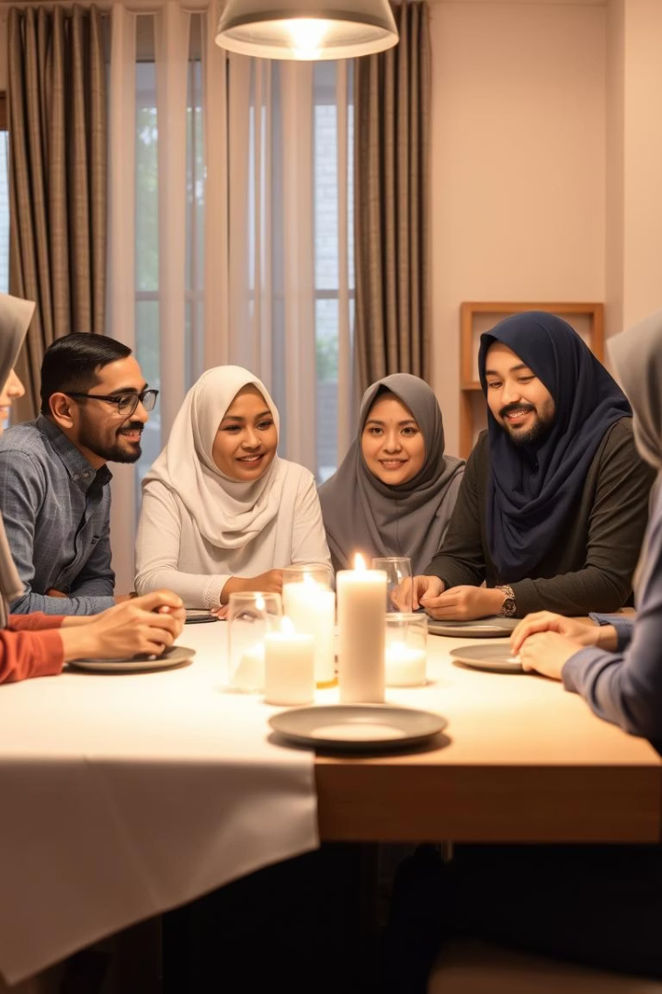
The Foundations and Boundaries of the Family in Islam
This presentation explores key aspects from Chapter 2 of The Family Structure in Islam by Hammudah Abd al Ati.
Discover the family’s definition, forms, roles, and its religious significance in Islam.

Slide 2
Group Members
Afaq Ahmed 55241
Muhammad Samiullah 53882
Faisal Munir 55416
Haseeb Ahmad 55197
Faisal Sharif 53307

Slide 3

A. Definition and Bases of the Family
Family as Social Unit
Mutual Rights & Responsibilities
Roots in Sharia & Ethics
Founded on the Nikah contract between man and woman.
Islamic law establishes family foundations and boundaries.
Emphasis on love, respect, and ethical duties.

Slide 4
B. Forms of the Family in Islam
Nuclear Family
Extended Family
Kinship Importance
Consists of husband, wife, and their children.
Includes multiple generations living together or nearby.
Strong ties support adaptability to cultures and economy.

Slide 5
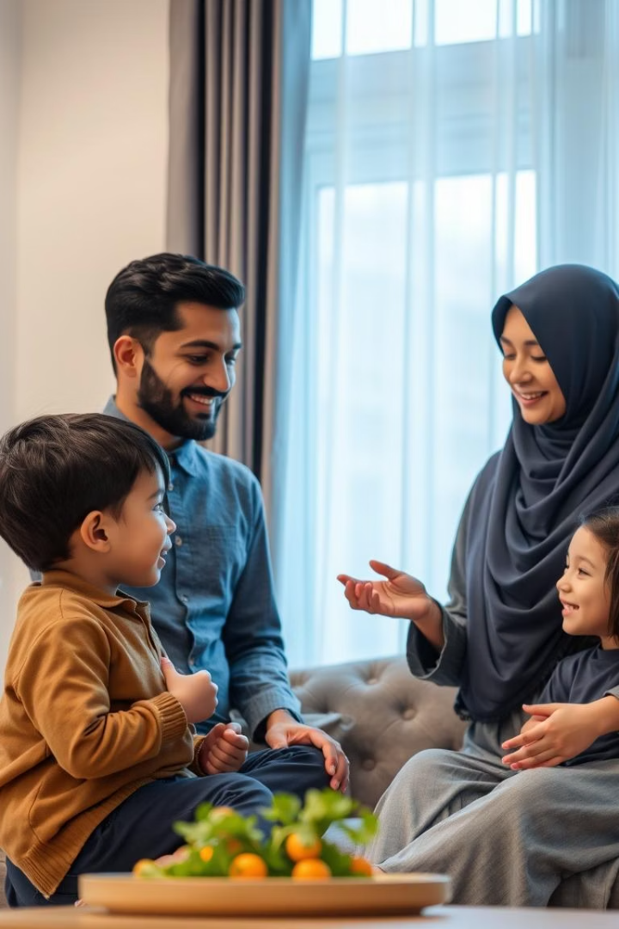
C. The Family Positions
Husband’s Role
Provider and protector of the family’s wellbeing.
Wife’s Role
Caretaker, homemaker, and children’s educator.
Children’s Duty
Respect and obey parents for family unity.
Family Harmony
Cooperation and consultation foster peace.

Slide 6
D. The Principle of Identity
Lineage Through Father
Preserving Heritage
Connection Over Time
Identity and family name traced paternally.
Maintaining genealogical records and family history.
Linking individuals to ancestors and descendants.

Slide 7
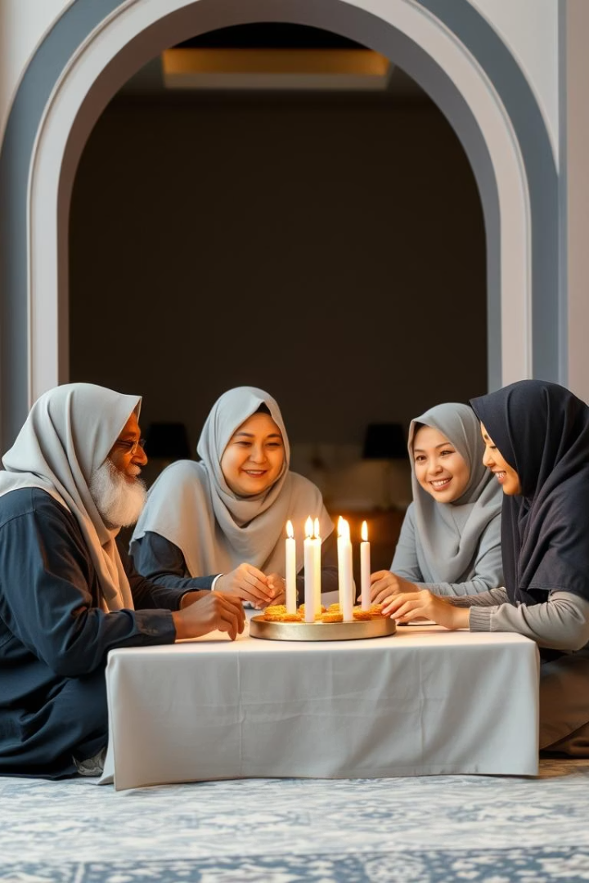
E. The Traditional Form of the Muslim Family
Strong Family Values
Cultural Norms
Emphasis on traditions and respect for elders.
Adherence to customs strengthens family bonds.
Passing Values
Islamic knowledge and morals shared across generations.

Slide 8
F. The Polygynous Form
Permitted Practice
Strict Conditions
Context & Debate
Polygyny allowed with regulations in Islam.
Justice, equality, and financial capability required.
Varied perspectives exist across Muslim communities.

Slide 9
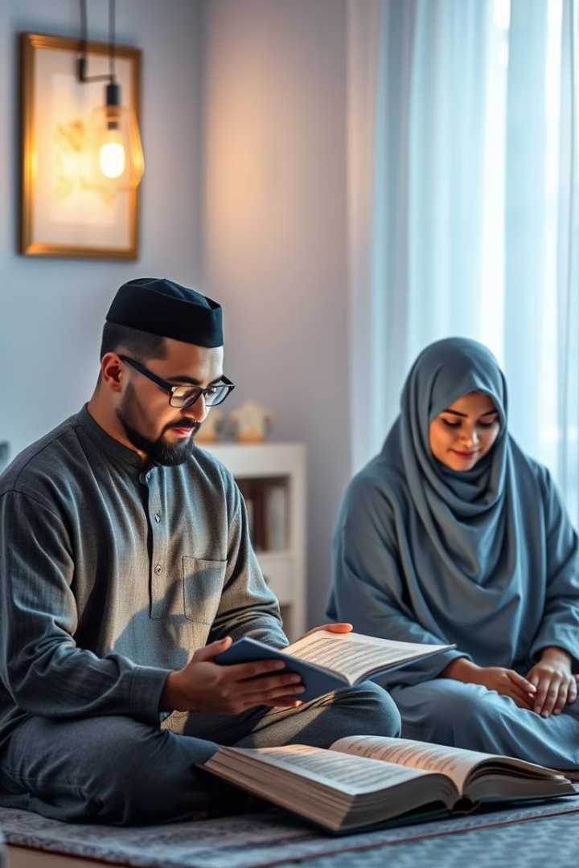
G. Is the Family a Religious Unit?
Core of Islamic Society
Spiritual Activities
Family forms the foundation of faith and morals.
Prayer, Quran study nurture faith within the family.
Strengthening Bonds
Faith connects family members and Allah deeply.

Slide 10
H. Perpetuation of the Family
Marriage & Procreation
Raising Righteous Children
Ummah Continuity
Marriage encouraged as foundation for continuing lineage.
Parenting considered a religious duty to nurture faith.
Supports survival and growth of the Muslim community.

Slide 11
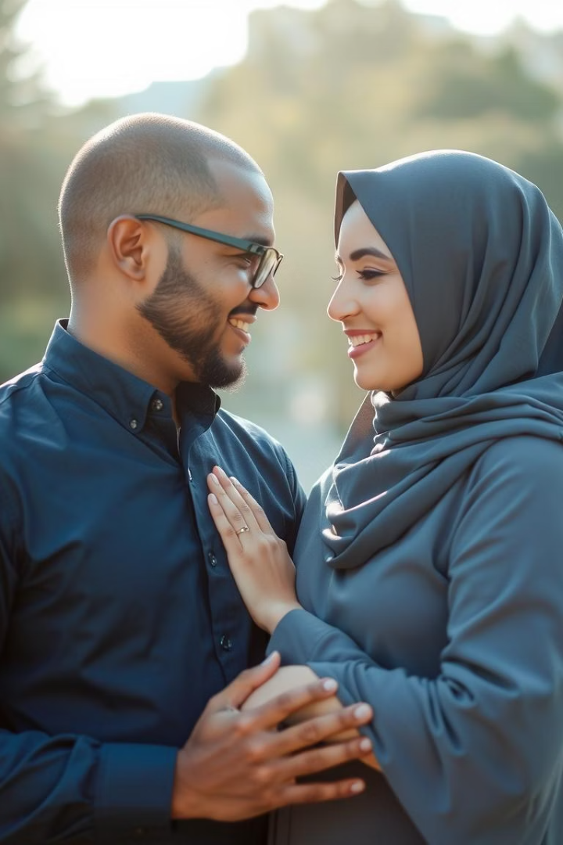
Conclusion
Cornerstone of Society
The family is essential to Islamic social structure.
Strong Foundations
Clear rights and ethical boundaries guide family life.
Mutual Responsibilities
Respect, love, and ethics enrich family relationships.
These principles reflect Islam’s profound wisdom and beauty.

Slide 12
SUMMARIZE
Family is the foundation of Islamic society – promotes love, stability, and morality.
Marriage is a sacred contract with mutual rights and responsibilities.
Defined roles for each member: husband, wife, children, and parents.
Equity, not sameness – men and women have different but complementary roles.
Islam sets boundaries to protect the family (no adultery, respect in relationships).
Divorce is allowed but discouraged – with steps for reconciliation.
Extended family & community ties are emphasized.
Goal: Spiritual, moral, and emotional growth within the family unit.

